Slide 1
Bug.sys
A fictional Subsidiary of polygames
Polygames is a fictional affiliate of Business Information Systems
BIS is a real program with Saskatchewan polytechnic

Slide 2
Mission statement
To effectively manage projects that produce complete products of high quality using a consistent methodology and effective communication.

Slide 3
motto
Process
= Product++
Product

Slide 4
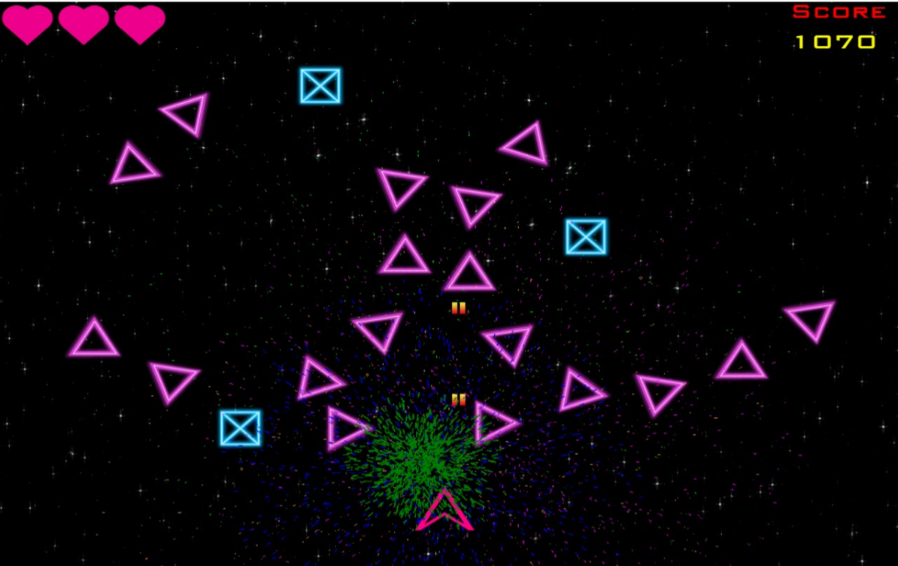
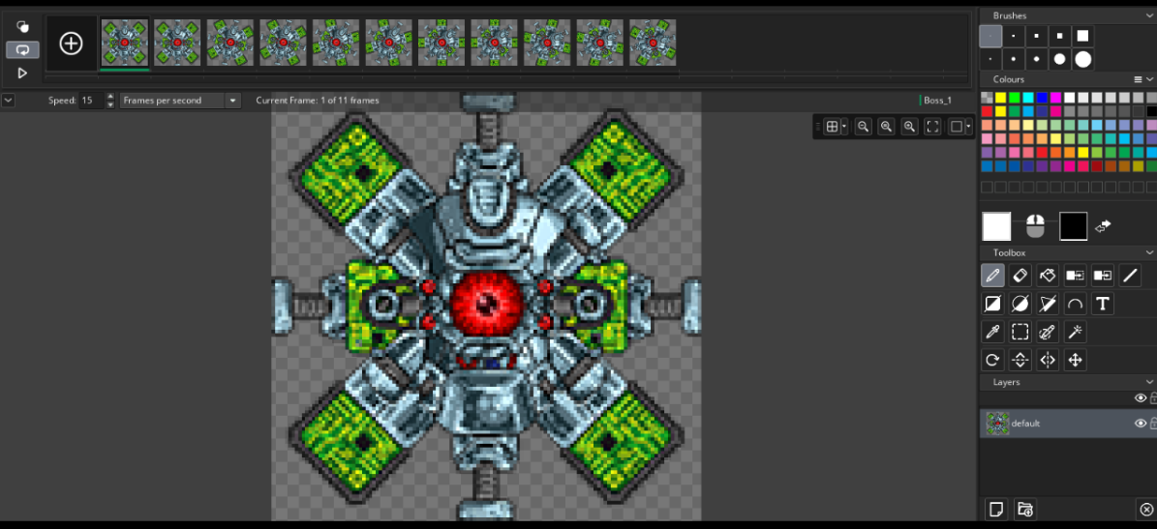
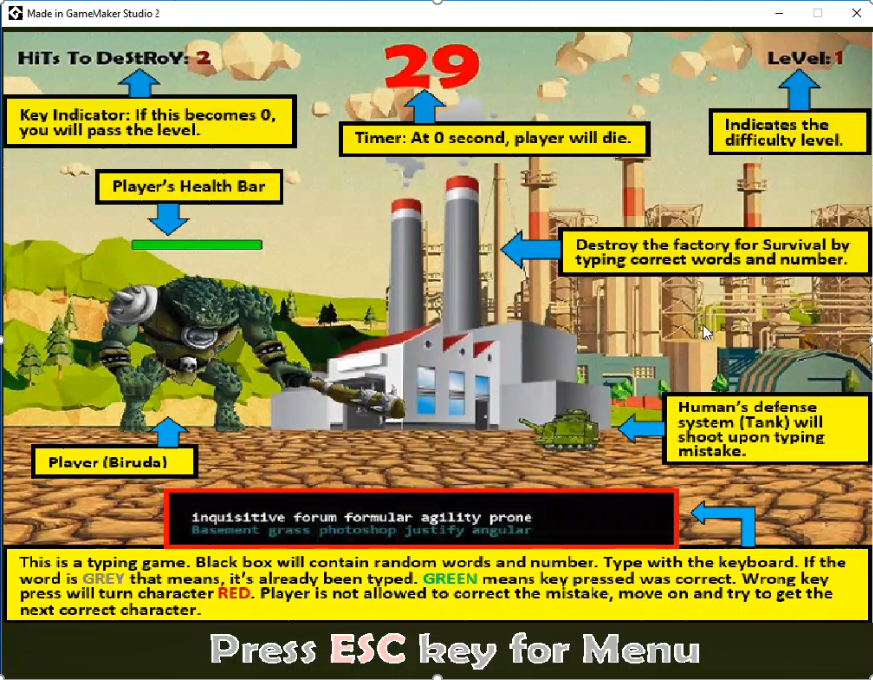
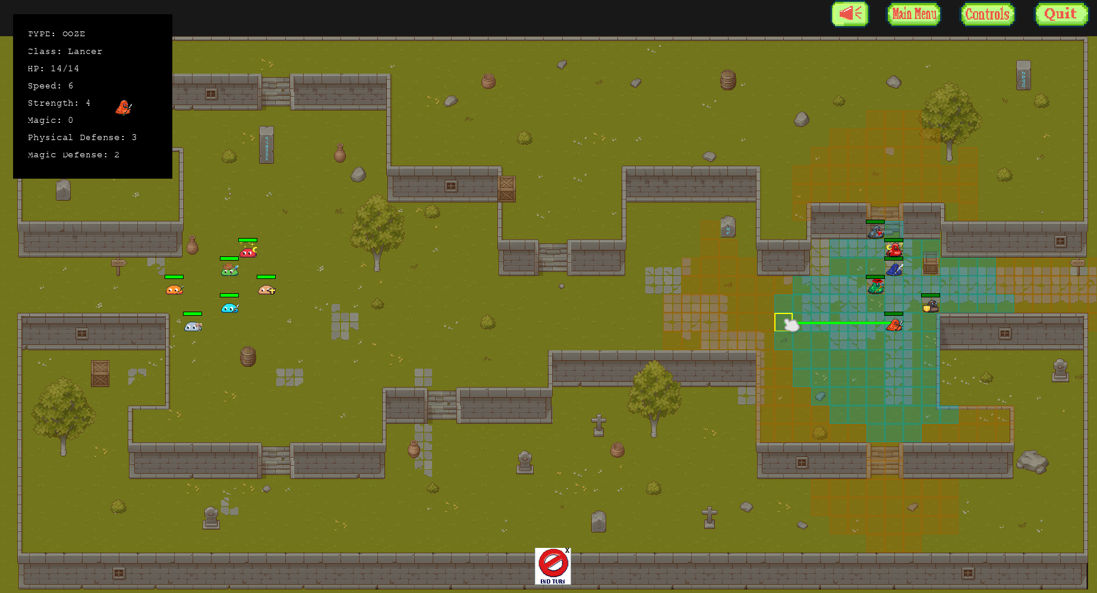
Our products

Slide 5
Our Process
Questions:
What are all the pieces of our project?
How long does each piece take?
Who will do what?
How will we monitor our project?
How and when will we communicate?
How will we handle change?
How will we handle risk?
Questions:
Why do this?
What is the cost of doing nothing?
What does success look like?
What does failure look like?
Can we do it?
The planning phase is where we perform detailed planning on how we will execute the project. We determine exactly what the project is, how long it will take and how much it will cost.
Questions:
Are we on schedule?
Are we behind?
Are we ahead?
Were our estimates correct?
Is the team getting along?
Are the sponsors happy?
Answers to these questions help us control the project, which involves modifying the plan, and perhaps redefining what success look like.
Once the plan is revised the iterative cycle continues. Execute the new plan, control execution and adjust as required. At some point after success, failure or something in between, the project is formally closed.
The initiation phase is where the project is approved, defined at a high level, and the stakeholders and teams are identified.
Then we execute our plan. We monitor our progress, team morale, obstacles, risks. Communication is the key. The plan doesn’t have to be perfect – but communication does.
Planning
Executing
Controlling
Initiating
A project is formally closed to ensure it is handed off to operations, to allow for a last round of team building, but most importantly to inform other projects of lessons learned along the way!
High level risk and reward decisions are made here and measured against feasibility
As we perform tasks, we reflect on the baseline plan. The goal is to identify variance early through scrums, status meetings, or informal communication.
Here we are concerned with scope & schedule (& budget).
Closing

Slide 6
Initiating
Planning
Executing
Controlling
Initiating
Closing

Slide 7
Initiating
Planning
Executing
Controlling
Initiating
Closing

Slide 8



Deliverables:
Co-location makes for more efficient teams
Self Identification form
Identify the team
Who am I?
Self directed team building activity
Initiating
Establish the work space
Build the team
Who are we?
Team building starts in initiation, but is critical in every phase of the project

Slide 9
INPUTS:
Request for Proposal (RFP)
Previous projects
Previous lessons learned reports
Assessment of your team
What am I doing here?
I need to define my project
Initiating
DELIVERABLES:
RFP Response document
Scope document
ACTIVITIES:
Brainstorming session
Design discussion and form RFP response
Scope discussion and creation

Slide 10
Has another team already done it?
Is your scope clearly defined?
Is it too big (or too small)?
Do the sponsors think it can be done?
Getting your design approved may have additional steps:
MINIMUM VIABLE PRODUCT
This feasibility analysis may include:
Locating tutorials
Gathering assets
Defining a smaller MVP
Using this to define success helps control scope and create a focus on quality.

Slide 11
Good RFP Responses documents should:
Good scope statements should:
Be communicative
Identify similar products
Communicate value
Identify risks and concerns
Use visuals, sketches, screen shots
What inspired you?
How did you get your idea?
Why should we green light your project?
Why will the panel like your project
What seems hard?
What seems big?
What don’t we know?
Have a SMART goal
Accurately enumerate collections
“There will be enemy flies” ☹
“There will be 2 types of enemy flies”☺
Define the MVP
Have a healthy wish list
Identify meaningful scope exclusions
Specific, Measurable, Achievable, Realistic, and Timely
What was raised and abandoned?
What from the “Other project features” are we not doing?
These recommendations are outlined in the document templates provided.

Slide 12

You have the team
You have a product idea
OK
Project Charter
And you have consensus
You have sponsors who approve of the product

Slide 13
Consensus?
Achieved through communications
Captured through sign-off
You’re all wrong!
Produces “alignment”
“What if I don’t agree with the rest of the team?”

Slide 14
Consensus doesn’t mean we all agree.
Invalid
Valid
That is just stupid
I don’t want to do that
You don’t know what you’re doing
You’re all wrong!
This can’t be done
We can’t do this
This seems risky
This is unprofessional
This is unethical/unfair

Slide 15
Consensus doesn’t mean we all agree.
You’re all wrong!
Valid
This can’t be done
We can’t do this
This seems risky
This is unprofessional
This is unethical/unfair
Perform feasibility activities
Risk management
Request governance from sponsors

Slide 16


Project Charter
Team and stakeholder contact info
Attendance and participation guidelines
Communication plan
Project time budget projections
Key dates (Milestones)
Team and sponsor signoff
Preliminary Risk
Game design and scope

Slide 17
Attendance and participation guidelines
Time budget calculations
INPUT
Calculate project capacity:
C = Total available hours from projected kickoff date to the presentation date.
H = Total available homework hours from projected kick off
L = Total lost hours due to projected potential absences
P = Planned absences (holidays, weddings etc.) calculated per individual
T = Team size
Capacity = (C + H - L) * T - P
Information can be found in your document templates

Slide 18
Time budget calculations
1-3 homework hours / week
Cross check with other groups
Work over breaks?
Did you check holidays?
Lessons learned from past groups

Slide 19
Milestone List
Phase | Duration | Ideal Progression Date
Initiation | ~ 2 weeks | September 12
Planning | ~ 3 weeks | October 3
Execution | ~ 7 weeks | December 5
Closing | ~ 2 weeks | December 17

Slide 20
DECEMBER 11
Revenge of
The Flytrap

Slide 21
What next?
Break into your teams
Brainstorm a team name
Must be submitted by end of first class
Review past material, discuss game idea
Access your team SharePoint

